Slide 1
Zomato: Food Delivery & Dining Case Study
Syed Zahed Hussain
PostgreSQL Project:1
Serving and slaying since 2008.

Slide 2
INTRODUCTION:
Zomato is an Indian multinational restaurant aggregator and food delivery company founded by Deepinder Goyal and Pankaj Chaddah in 2008.
Zomato provides information, menus and user-reviews of restaurants as well as food delivery options from partner restaurants in selected ctites.
As of 2019, the service is available in 24 countries and in more than 10000 cities.
Zomato rivals Swiggy in food delivery and hyperlocal space.

Slide 3
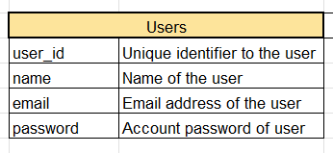
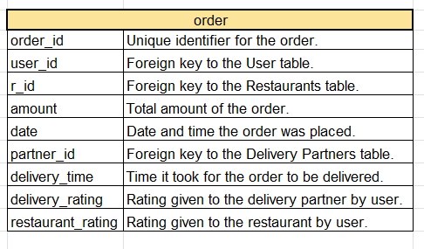
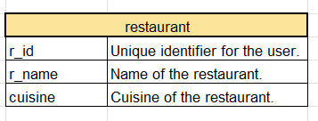
ABOUT DATA AND TABLES:

Slide 4

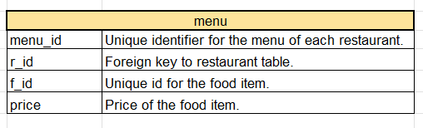
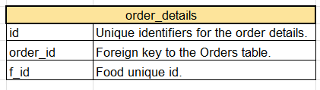
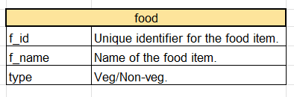
ABOUT DATA AND TABLES:

Slide 5
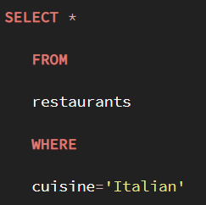

Q1. Get all columns from the restaurants table where the cuisine is 'Italian’.

Slide 6
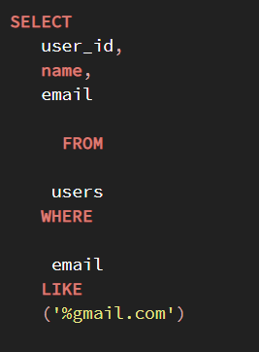
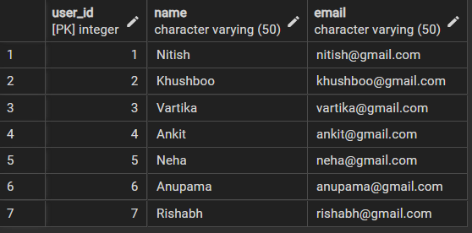
Q2. Display the user IDs and names of users whose email addresses contain 'gmail.com'.

Slide 7
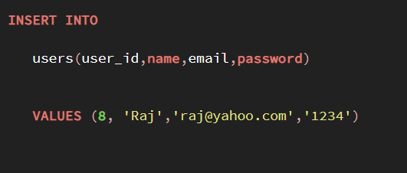
Q3. Inserting yahoo users in the database.

Slide 8
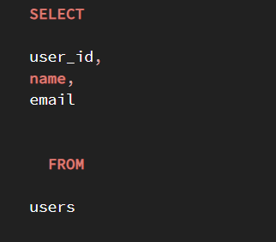
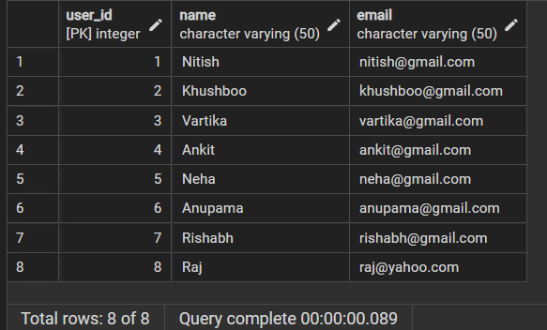
Q.4 Get the user IDs, names, and email addresses of users from the users table.

Slide 9
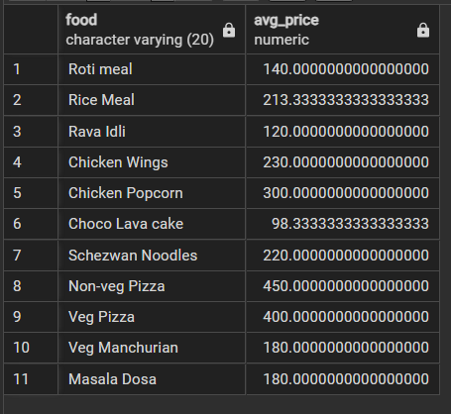
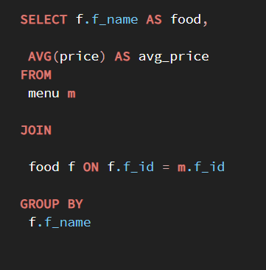
Q.5 Average Price Per Dish.

Slide 10
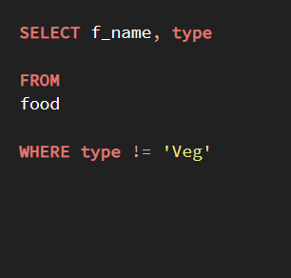
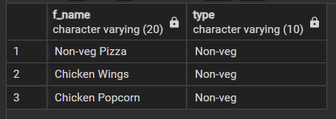
Q6. Retrieve the names and types of food items from the food table where the type is not 'Veg'.

Slide 11
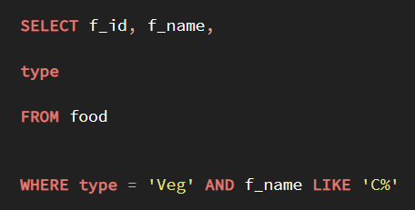

Q.7 Fetch the IDs, names, and types of food items from the food table where the type is 'Veg' and the name starts with 'C'.

Slide 12
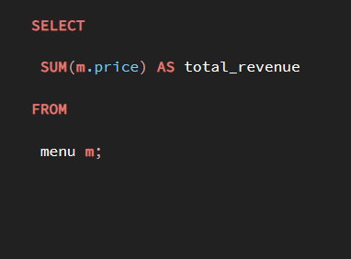
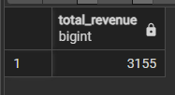
Q.8 Calculate Total Revenue: Calculate the total revenue generated from all orders.

Slide 13
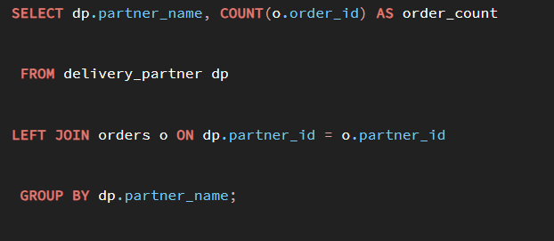
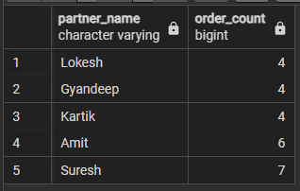
Q.9 Retrieve the partner names along with the count of orders they have placed.

Slide 14

ABOUT ME:
Hi, Its Zahed
I am currently 2nd year engineering student with specialisation in Artificial Intelligence and Data Science. Along with my current degree I am enrolled in Data Analaytics Batch from ARC Technologies to improve myself day by day. Additionally I am currently working as an intern in a Mumbai startup called CineStox where I applied my current knowledge to improve the efficiency of the company.
LinkedIn:
G-mail:syedzahed7778@gmail.com

